Slide 1
OBJECT MODELLING
Lecture 20

Slide 2
Object
Object
Modeling
noun
verb
Plan according to reach the goal!
Goal or Reason
Visualizing elements in applications in the form of objects
Object
Modeling

Slide 3
Steps in Object modeling!
System analysis
System design
Object design
Implementation

Slide 4
Let’s take a simple example!
Object Model of Deck of Cards
Step 1: System Analysis
Problem statement
Problem statement : generate and display the deck of cards value

Slide 5
Card display
Class Card:
Generate the cards
Class Deck:
Call to generate the cards

Slide 6

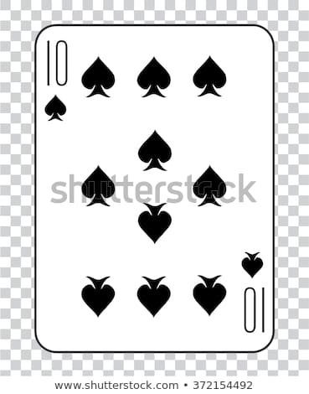
Suit : Hearts
Suit : Spades
Face Value : Ace
Face Value : 10

Slide 7
"Hearts",
"Clubs",
"Diamonds",
"Spades"
Suit value
Card
4
"Ace",
"2",
"3",
"4",
"5",
"6",
"7",
"8",
"9",
"10",
"Jack","Queen","King"
Face value
13

Slide 8
//create arrays for card labels
String[] SUITS =
{
"Clubs", "Diamonds", "Hearts", "Spades"
};
String[] RANKS =
{
"2", "3", "4", "5", "6", "7", "8", "9", "10",
"Jack", "Queen", "King", "Ace"
};
int n = 4 * 13;
String[] deck = new String[n];

Slide 9
For a single card!
class Card
{
void disp(int i,int j)
{
System.out.println(RANKS[j] + " of " + SUITS[i]);
}
};

Slide 10
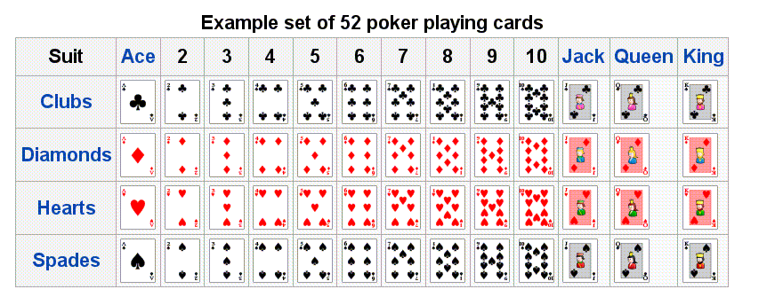
But it should be done for all the 52 cards!!

Slide 11
Therefore
public class Function extends Card
{
public static void main(String args[])
{
Card C=new Card();
for (int i = 0; i < 4; i++)
{
for (int j = 0; j < 13; j++)
{
C.disp(i,j);
}
}
}
}
Call the Card class to print every single card!!
This is to display the deck of cards!

Slide 12

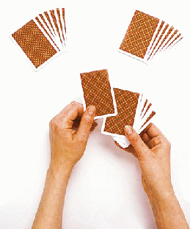
To shuffle the cards!
Initialize an array and store the deck of cards
Shuffle the cards

Slide 13
To initialize !
void Initialize()
{
//int n = 4 * 13;
for (int i = 0; i < 4; i++)
{
for (int j = 0; j < 13; j++)
{
deck[SUITS.length*j + i] = RANKS[j] + " of " + SUITS[i];
}
}
}

Slide 14
To shuffle !
void shuffle()
{
// shuffle
for (int i = 0; i < n; i++)
{
int r = i + (int) (Math.random() * (n-i));
String temp = deck[r];
deck[r] = deck[i];
deck[i] = temp;
}
for (int i = 0; i < n; i++)
{
System.out.println(deck[i]);
}
}

Slide 15
Therefore
public class Function extends Card
{
public static void main(String args[])
{
Card C=new Card();
for (int i = 0; i < 4; i++)
{
for (int j = 0; j < 13; j++)
{
C.disp(i,j);
}
}
}
}
Call the Card class to print every single card!!
This is to display the deck of cards!
C.Initialize();
C.shuffle();

Slide 16
class Card
{
public
String[] SUITS =
{
"Clubs", "Diamonds", "Hearts", "Spades"
};
String[] RANKS =
{
"2", "3", "4", "5", "6", "7", "8", "9", "10",
"Jack", "Queen", "King", "Ace"
};
int n = 4 * 13;
String[] deck = new String[n];
void disp(int i,int j)
{
System.out.println(RANKS[j] + " of " + SUITS[i]);
}
void Initialize()
{
//int n = 4 * 13;
for (int i = 0; i < 4; i++)
{
for (int j = 0; j < 13; j++)
{
deck[SUITS.length*j + i] = RANKS[j] + " of " + SUITS[i];
}
}
}

Slide 17
void shuffle()
{
// shuffle
for (int i = 0; i < n; i++)
{
int r = i + (int) (Math.random() * (n-i));
String temp = deck[r];
deck[r] = deck[i];
deck[i] = temp;
}
for (int i = 0; i < n; i++)
{
System.out.println(deck[i]);
}
}
public class Function extends Card
{
public static void main(String args[])
{
Card C=new Card();
for (int i = 0; i < 4; i++)
{
for (int j = 0; j < 13; j++)
{
C.disp(i,j);
}
}
C.Initialize();
C.shuffle();
}
}

Slide 18
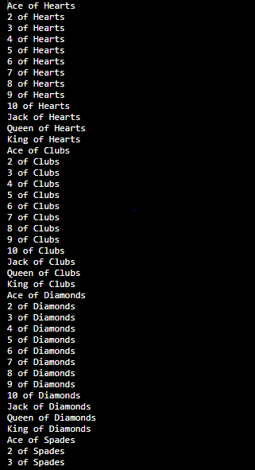
OUTPUT

Slide 19


Notes:
Doubts???

Slide 20
Thank you!

